Slide 1
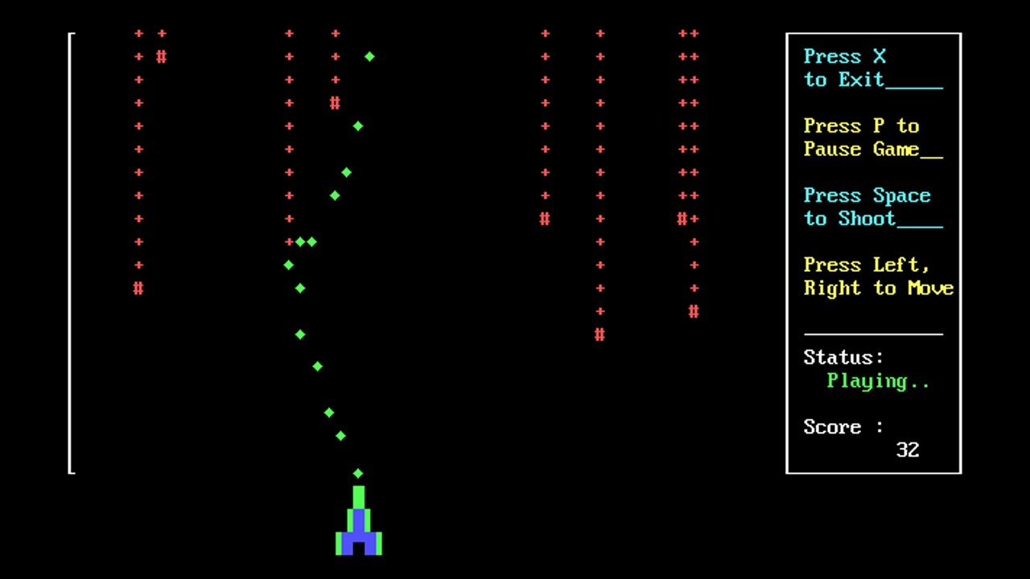
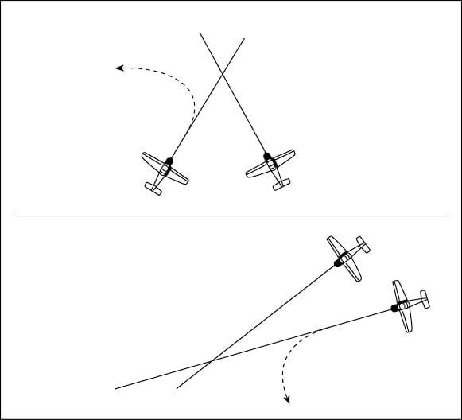
Air Craft
Idea of what it could look like?
Easy Display Game
Move Left a
Move Right d
Move Down s
Move Up w
Shooting Space
Scoring on the Right side
Display Shooting Scoring
Should have:
Able to handling errors from user inputs
Game ends when all player’s air have been destroyed
Game instructions
Nice to have:
A main menu
Player statistics
Hit/miss ratio
Win/loss ratio
Games played
Enemy AI to take computer turns
Games saved – to be continued later

Slide 2
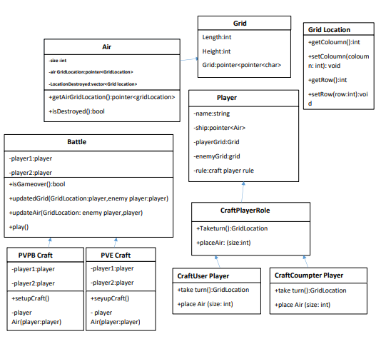
Explain With a digram
Planning with nice-to-have features in-mind:​
The Player vs Computer mode is not a must-have or should-have feature, but I have considered how this could be implemented as I wanted a structure that would allow this functionality to be added with minor changes to the rest of the code.​
Rules of Air craft game
During development I had to make additional changes to my air ceaft diagram. For example, instead of storing an integer variable “size” for air instances I implemented a method to return the size of the array storing the locations belonging to the air. The “size” variable would have been taking up unneccassary memory as the size of a air can be calculated.
I also realized that I needed to store a pointer to the player object in the classes which implement the air pilot PlayerRole ‘interface’ class..

Slide 3
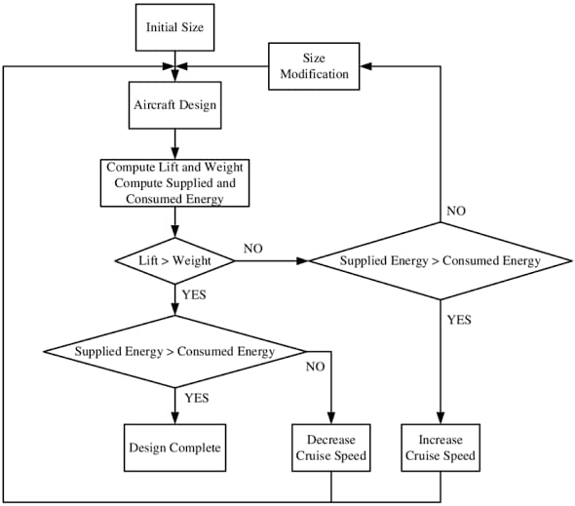
Game sequence diagram
Should have:
Able to handling errors from user inputs ✔
Game ends when all player’s ships have been destroyed ✔
Game instructions
Nice to have:
A main menu ✔
Player statistics
Enemy AI to take computer turns
Games saved – to be continued later
Area as seen from the Front of the Plane . include enemy tanks that shoot at you to have the plane shoot and have health etc. Speed of the incoming your enemy you seen. When you stop the game the game stop then you another time you can start the game. You can move left right easily and find the enemy and you killed them. When your powers loose you can get the powers called bounces and then your health is better.

Slide 4
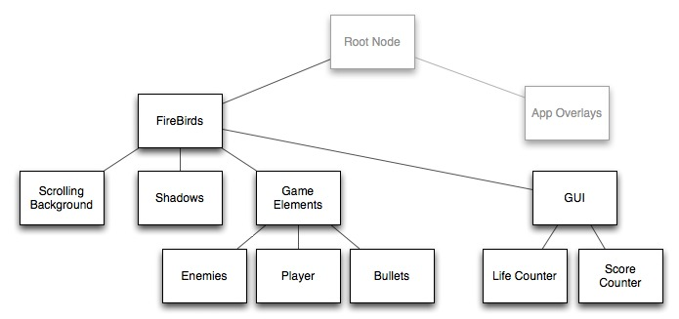
Challenge
Real-time performance constraints
Continuous development and modification
Maintains “verisimilitude” = realism, as the airplanes changed specs
Large size and high complexity
Developed in geographically distributed areas

Slide 5
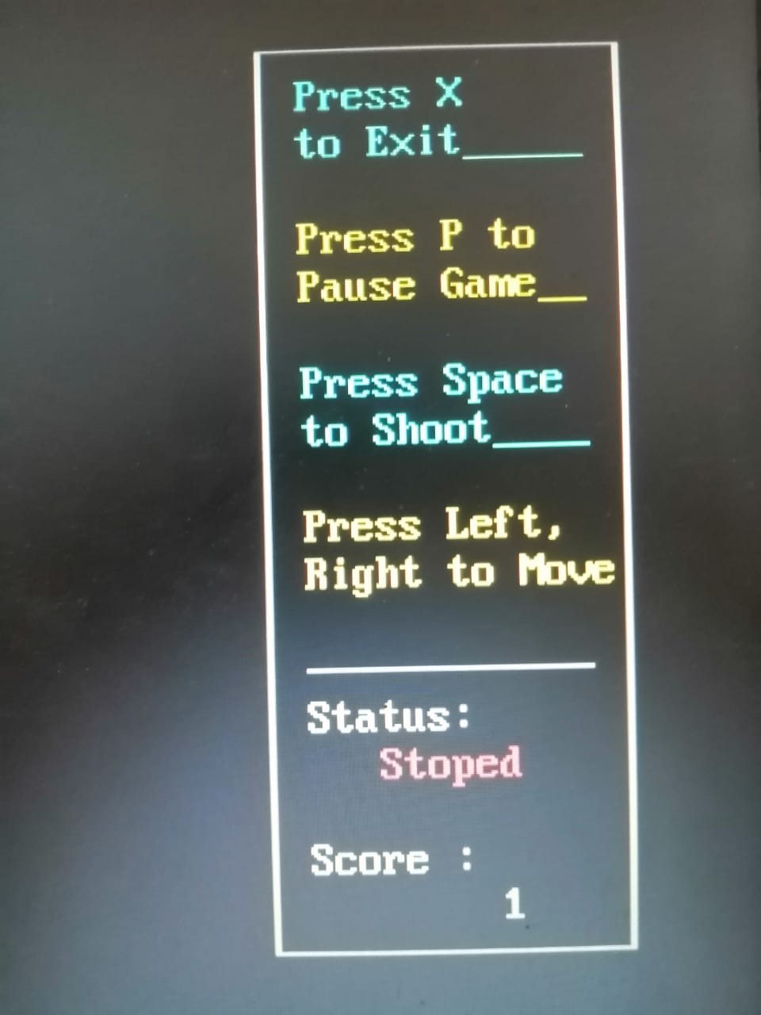
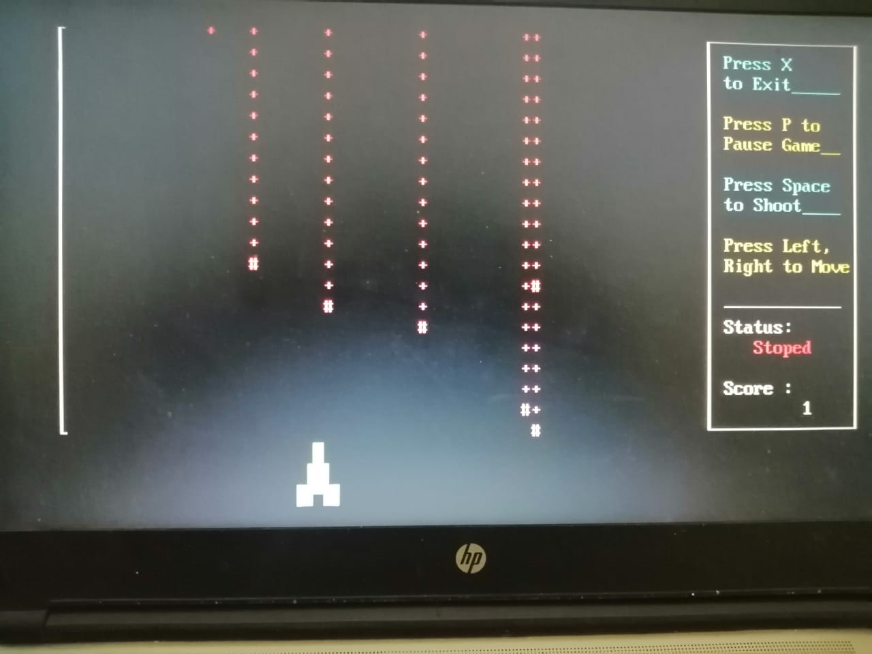
Expensive to debug, test, and modify
Increased cost of integration
Unclear mapping between software structure and aircraft structure
Many coupling effects to be considered
E.g., pilot moves the rudder and aileron controls, which move the control surfaces, which affects the aerodynamics and causes the aircraft to turn.
Performance “fidelity” is # 1 goal

Slide 6
Summary
How the architecture achieves…
Performance
Executive with time budgets, and
Periodic scheduling strategy
Integrality
All data and control pass through a subsystem controller as an intermediary
Each partition was restricted in inputs and outputs
Modifiability
Few base module configurations for the designer and maintainer to understand

